Slide 1



Slide 2







Who is Chad Green
chadgreen@chadgreen.com
TaleLearnCode
ChadGreen.com
ChadGreen & TaleLearnCode
ChadwickEGreen

Slide 3
Agenda
What is Technical Debt
Technical Debt Statistics
Pros and Cons of Technical Debt
What Causes Technical Debt
Technical Debt Identification
Tracking & Managing Technical Debt

Slide 4
What is Technical Debt
Technical Debt is not Free

Slide 5

What is Technical Debt?
A story as old as time
Notes:
Once upon a time, there was a software development team that was working on a project for a big client. The project was complex, and the deadline was tight, so the team decided to take shortcuts and make quick fixes instead of following best practices.
At first, everything seemed to be going well. The project was delivered on time and the client was happy with the results.
However, as time went on,

Slide 6

What is Technical Debt?
A story as old as time
Notes:
the team realized that the shortcuts they had taken were causing problems.
The code was difficult to read and maintain, which made it time-consuming and expensive to fix bugs. The team also realized that they had neglected to properly document the code,

Slide 7

What is Technical Debt?
A story as old as time
Notes:
which made it difficult for new developers to understand how the system worked.
Furthermore, the team had not done enough testing, which resulted in a high number of bugs. And the architecture of the system was overly complex, which made it difficult to make changes without breaking other parts of the system.

Slide 8

What is Technical Debt?
A story as old as time
Notes:
As a result of these problems, the team found themselves spending more and more time fixing bugs and maintaining the system instead of working on new features.

Slide 9

What is Technical Debt?
A story as old as time
Notes:
The client was also becoming frustrated because the system was not performing as well as they had hoped.
The team eventually realized that the shortcuts they had taken were the cause of their problems. They had accumulated a significant amount of technical debt, which as making it difficult for them to deliver the quality software that their client required.

Slide 10

What is Technical Debt?
A story as old as time
Notes:
The stress of the situation was taking a toll on the team. Developers were working long hours and feeling overwhelmed, which was affecting their morale and their health.

Slide 11

What is Technical Debt?
A story as old as time
Notes:
Some even started to look for new jobs because they did not want to work on a project that was so difficult to maintain.
In the end, the team realized that the shortcuts they had taken were the cause of their problem. They had accumulated a significant amount of technical debt, which was making it difficult for them to deliver the quality software that their client required.

Slide 12

What is Technical Debt?
A story as old as time
Notes:
The team had to work hard to pay off their technical debt, which took a lot of time and money.

Slide 13

What is Technical Debt?
A story as old as time
Notes:
They also had to find new developers to replace those who had left, which added to their difficulties.

Slide 14

What is Technical Debt?
A story as old as time
Notes:
From then on, the team was more careful to follow best practices and avoid technical debt. They learned the hard way about the importance of taking the time to do things right, even if it means delivering the project a little late. They also made sure to prioritize their health and well-being, so that they could continue to deliver high-quality software for their clients.

Slide 15

What is Technical Debt?
First described by Ward Cunningham in 1992
The danger occurs when the debt is not repaid.
Notes:
“Shipping first-time code is like going into debt. A little debt speeds development so long as it is paid back promptly with a rewrite. Objects make the cost of this transaction tolerable.
The danger occurs when the debt is not repaid.
Every minute spent on not-quite-right code counts as interest on that debt.
Entire engineering organizations can be brought to a stand-still under the debt load of an unconsolidated implementation, object-oriented or otherwise."

Slide 16
What is Technical Debt?
First described by Ward Cunningham in 1992
Every minute spent on not-quite-right code counts as interest on that debt.
Notes:
“Shipping first-time code is like going into debt. A little debt speeds development so long as it is paid back promptly with a rewrite. Objects make the cost of this transaction tolerable.
The danger occurs when the debt is not repaid.
Every minute spent on not-quite-right code counts as interest on that debt.
Entire engineering organizations can be brought to a stand-still under the debt load of an unconsolidated implementation, object-oriented or otherwise."

Slide 17
What is Technical Debt?
First described by Ward Cunningham in 1992
…brought to a stand-still under the debt load of an unconsolidated implementation
Notes:
“Shipping first-time code is like going into debt. A little debt speeds development so long as it is paid back promptly with a rewrite. Objects make the cost of this transaction tolerable.
The danger occurs when the debt is not repaid.
Every minute spent on not-quite-right code counts as interest on that debt.
Entire engineering organizations can be brought to a stand-still under the debt load of an unconsolidated implementation, object-oriented or otherwise."

Slide 18

What is Technical Debt?
Common definition from Martin Fowler
quick and dirty way
Notes:
In this metaphor, doing things
the quick and dirty way sets us up with a technical debt, which is similar to a financial debt. Like a financial debt, the technical debt
incurs interest payments, which come in the form of the
extra effort that we have to do in future development.

Slide 19
What is Technical Debt?
Common definition from Martin Fowler
incurs interest payments
Notes:
In this metaphor, doing things
the quick and dirty way sets us up with a technical debt, which is similar to a financial debt. Like a financial debt, the technical debt
incurs interest payments, which come in the form of the
extra effort that we have to do in future development.

Slide 20
What is Technical Debt?
Common definition from Martin Fowler
extra effort that we have to do in future development
Notes:
In this metaphor, doing things
the quick and dirty way sets us up with a technical debt, which is similar to a financial debt. Like a financial debt, the technical debt
incurs interest payments, which come in the form of the
extra effort that we have to do in future development.

Slide 21

What is Technical Debt?
implied cost
Notes:
The implied cost of additional
rework caused by
choosing an easy (limited) solution now instead of using a
better approach that would take longer.

Slide 22
What is Technical Debt?
rework
Notes:
The implied cost of additional
rework caused by
choosing an easy (limited) solution now instead of using a
better approach that would take longer.

Slide 23
What is Technical Debt?
choosing easy
Notes:
The implied cost of additional
rework caused by
choosing an easy (limited) solution now instead of using a
better approach that would take longer.

Slide 24
What is Technical Debt?
better approach
Notes:
The implied cost of additional
rework caused by
choosing an easy (limited) solution now instead of using a
better approach that would take longer.

Slide 25
A more reasonable definition
A state of unnecessary complexity, duplication, subpar code, or otherwise deficient code that introduces risks in the form of time, quality, security, team morale, or other forms. Typically the results of past action or inaction.
Matt Eland
Killalldefects.com/2019/12/23/defining-technical-debt

Slide 26
Technical Debt is Bad

Slide 27
Technical Debt is Bad

Slide 28
Technical Debt can be Bad

Slide 29
Technical Debt can be Devastating

Slide 30
Technical Debt can be Useful

Slide 31
Technical Debt can be Beneficial

Slide 32
Technical Debt is not Free

Slide 33
Technical Debt Statistics
Technical Debt is not Free
Notes:
While it may be challenging to quantify the impact of technical debt universally, as it can vary across projects and organizations, several studies and surveys have shed light on the consequences of accumulating technical debt. Here are some statistics and findings that highlight the challenges associated with technical debt:

Slide 34
Technical Debt Statistics
Causes Delays and Reduced Productivity
Notes:
According to a 2018 survey by Stripe, technical debt was cited as the leading cause of delays in shipping new features by 41% of respondents.

Slide 35
Technical Debt Statistics
Causes Delays and Reduced Productivity
Impact on Development Speed
Notes:
A study conducted by the Consortium for IT Software Quality (CISQ) found that software developers spend an average of 41% of their time dealing with technical debt.

Slide 36
Technical Debt Statistics
Causes Delays and Reduced Productivity
Impact on Development Speed
Increased Maintenance Costs
Notes:
Capers Jones, a software measurement expert, has estimated that for every hour spent on new software development, an additional three to four hours are spent on maintenance, much of which can be attributed to managing technical debt.

Slide 37
Technical Debt Statistics
Causes Delays and Reduced Productivity
Impact on Development Speed
Increased Maintenance Costs
Quality and Performance Issues
Notes:
The same Stripe survey mentioned earlier found that 68% of respondents reported that technical debt had a negative impact on their codebase's quality.

Slide 38
Technical Debt Statistics
Causes Delays and Reduced Productivity
Impact on Development Speed
Increased Maintenance Costs
Quality and Performance Issues
Higher Defect Rates
Notes:
A study published in the Journal of Systems and Software found a positive correlation between the amount of technical debt in a codebase and the number of defects. As technical debt increases, so does the defect density.

Slide 39
Technical Debt Statistics
Causes Delays and Reduced Productivity
Impact on Development Speed
Increased Maintenance Costs
Quality and Performance Issues
Higher Defect Rates
Reduced Innovation
Notes:
The State of DevOps Report has indicated that organizations with high levels of technical debt are less likely to innovate successfully, as they spend more time dealing with operational issues and less time on new features.

Slide 40
Technical Debt Statistics
Causes Delays and Reduced Productivity
Impact on Development Speed
Increased Maintenance Costs
Quality and Performance Issues
Higher Defect Rates
Reduced Innovation
Employee Morale
Notes:
The negative impact of technical debt on code quality and development speed can contribute to lower employee morale. A study by Code Climate found that developers are less satisfied with their work when dealing with a high level of technical debt.

Slide 41
Technical Debt Statistics
Causes Delays and Reduced Productivity
Impact on Development Speed
Increased Maintenance Costs
Quality and Performance Issues
Higher Defect Rates
Reduced Innovation
Employee Morale
Customer Satisfaction
Notes:
A report from CAST Software suggests that technical debt can negatively impact customer satisfaction, as it leads to more system outages and unplanned work.

Slide 42
Technical Debt Statistics
Causes Delays and Reduced Productivity
Impact on Development Speed
Increased Maintenance Costs
Quality and Performance Issues
Higher Defect Rates
Reduced Innovation
Employee Morale
Customer Satisfaction
Notes:
It's important to note that these statistics may vary depending on the industry, the nature of the software being developed, and the specific practices of individual development teams. However, the consensus is that managing and minimizing technical debt is crucial for maintaining a healthy and sustainable software development process.

Slide 43
Pros and Cons of Technical Debt
Technical Debt is not Free

Slide 44
Technical Debt Pros
Supplier
Customer
Faster time to market
Short term competitive advantage
New features faster
Short term capital preservation

Slide 45
Technical Debt Cons
Supplier
Customer
Degradation of quality
Limits ability to innovate
Longer development cycles
Less responsive to market changes
Customer churn
Developer churn
Higher upgrade costs
System compatibility issues
Poor end user experience
Less responsive to market changes
Poor IT morale

Slide 46
(Bad) Technical Debt Example
No User Roles
Notes:
You start writing an application. In the beginning there is no need for user roles. Everyone can do anything.

Slide 47
(Bad) Technical Debt Example
No User Roles
Permission for Specific Requirement
Notes:
At some point you start having two different permissions for a specific action, like one kind of user can see a report and the others can’t. The tech team considers whether to create a full fledged permission system, using a nice set of design patterns for it. But at this point it really looks like over engineering. One method in the business logic and one in the presentation layer will do.

Slide 48
(Bad) Technical Debt Example
No User Roles
Permission for Specific Requirement
Differentiation of Users
Notes:
Some time later another thing requires the differentiation of users, and then another and another. At this point the developers realize that the code is starting to get messy and the solution is refactoring it to have a decent permission system. To make this refactoring will take way more time than just adding another method, but will simplify the code and make future permissions to be added with one line of code, or even by just adding a row in the database.

Slide 49
(Bad) Technical Debt Example
No User Roles
Permission for Specific Requirement
Differentiation of Users
Yet Another Permission Change
Notes:
The company has the opportunity to add five customers in a week – but really need another permission change in a couple of days
The problem is that there really is a business need to have the current permission live in one or two days, ‘cause this will make five potential customers sign a contract this week, rather than next week, or maybe never, if they dislike the fact that the company haven’t done their only request.

Slide 50
(Bad) Technical Debt Example
No User Roles
Permission for Specific Requirement
Differentiation of Users
Yet Another Permission Change

Slide 51
(Good) Technical Debt Example
.NET 5
Current Release
.NET 6
LTS Release
.NET 8
LTS Release
Notes:
Long Term Support (LTS) _ LTS releases are supported for three years after the initial release.
Current – Current releases are supported for six months after a subsequent Current or LTS release. Release happen every 12 months, so the support period for Current is 18 months.
.NET 5 – Original Release Date – November 10, 2020
.NET 5 – End of Support – May 10, 2022
.NET 6 – Original Release Date – November 8, 2021
.NET 6 – End of Support – November 12, 2024
.NET 7 – Original Release Date – November 8, 2022
.NET 7 – End of Support – May 14, 2024
.NET 8 – Original Release Date – November 14, 2023
.NET 8 – End of Support – November 10, 2026

Slide 52
What Causes Technical Debt?
Technical Debt is not Free

Slide 53

Insufficient up-front definition
What causes technical debt?
Notes:
Insufficient up-front definition, where requirements are still being defined during development, development starts before any design takes place. This is done to save time but often has to be reworked later.

Slide 54

Business Pressures
What causes technical debt?
Notes:
Business pressures, where the business considers getting something released sooner before all of the necessary changes are complete, builds up technical debt comprising those uncompleted changes.

Slide 55

Lack of process or understanding
What causes technical debt?
Notes:
Lack of process or understanding, where businesses are blind to the concept of technical debt, and make decisions without considering the implications.

Slide 56

Tightly-coupled components
What causes technical debt?
Notes:
Tightly-coupled components, where functions are not modular, the software is not flexible enough to adapt to changes in business needs.

Slide 57

Lack of a test suite
What causes technical debt?
Notes:
Lack of a test suite, which encourages quick and risky band-aids to fix bugs.

Slide 58
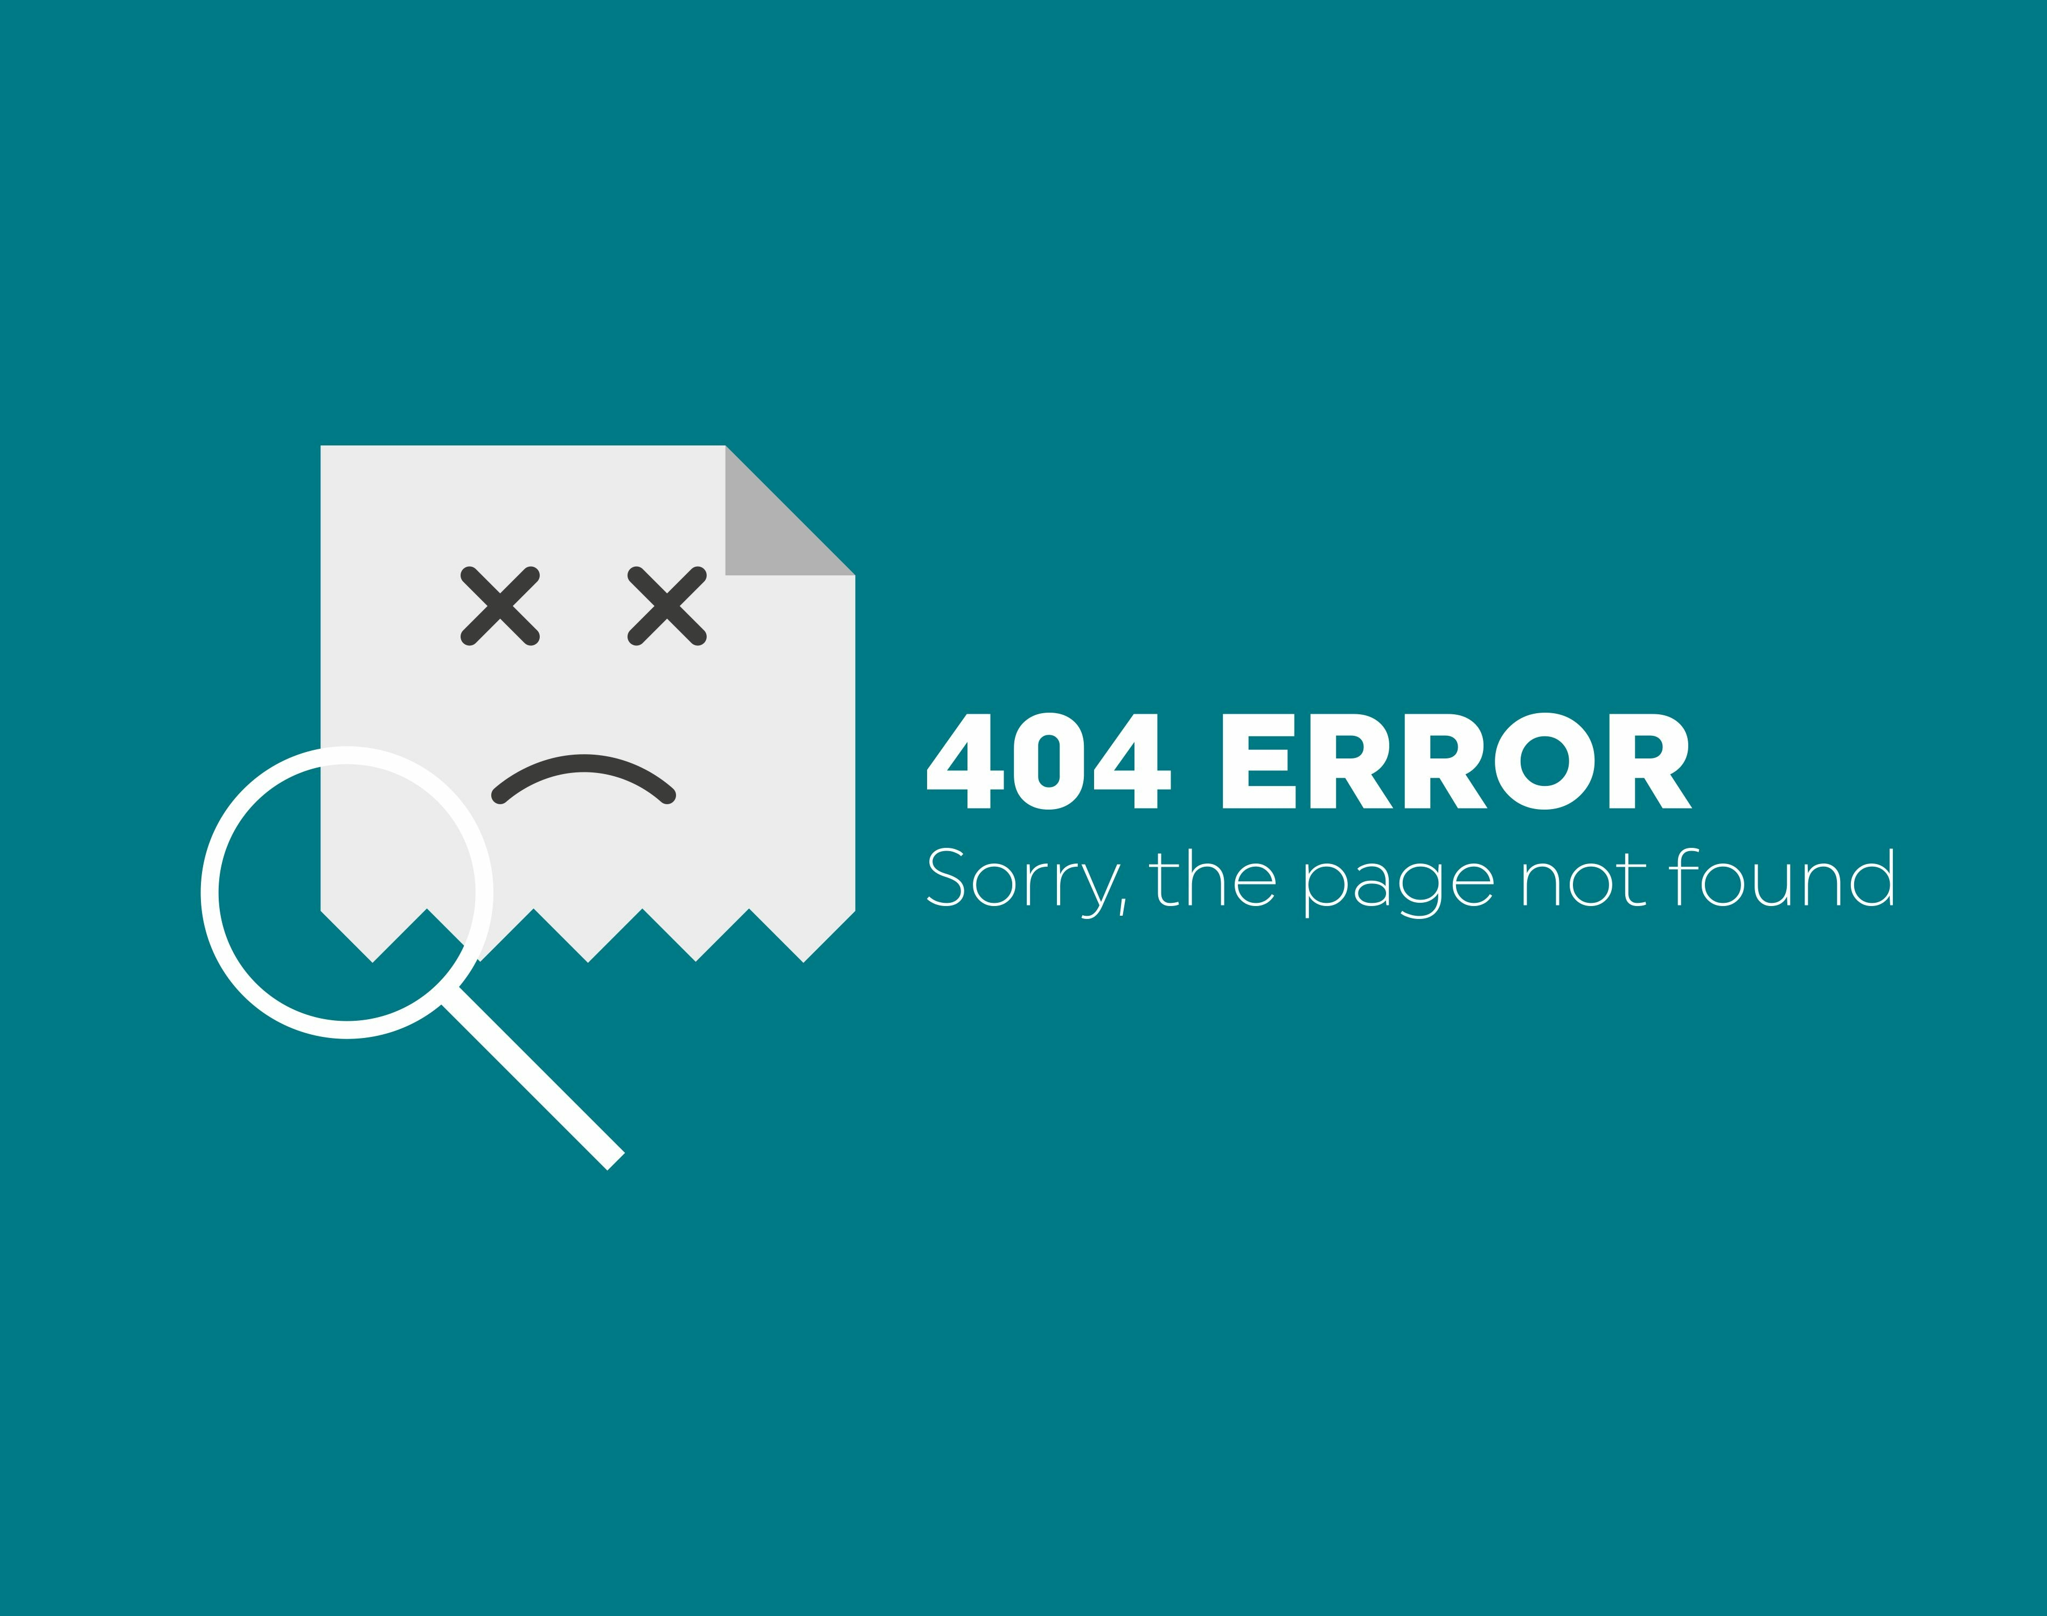
Lack of documentation
What causes technical debt?
Notes:
Lack of documentation, where code is created without necessary supporting documentation. The work to create any supporting documentation represents a debt that must be paid.

Slide 59

Lack of collaboration
What causes technical debt?
Notes:
Lack of collaboration, where knowledge isn't shared around the organization and business efficiency suffers, or junior developers are not properly mentored.

Slide 60

Parallel development
What causes technical debt?
Notes:
Parallel development on two or more branches accrues technical debt because of the work required to merge the changes into a single source base. The more changes that are done in isolation, the more debt is piled up.

Slide 61

Delayed refactoring
What causes technical debt?
Notes:
Delayed refactoring – As the requirements for a project evolve, it may become clear that parts of the code have become inefficient or difficult to edit and must be refactored in order to support future requirements. The longer that refactoring is delayed, and the more code is added, the bigger the debt.

Slide 62

Lack of alignment to standards
What causes technical debt
Notes:
Lack of alignment to standards, where industry standard features, frameworks, technologies are ignored. Eventually, integration with standards will come, doing sooner will cost less (similar to 'delayed refactoring').

Slide 63

Lack of knowledge
What causes technical debt?
Notes:
Lack of knowledge, when the developer simply doesn't know how to write elegant code.

Slide 64

Lack of ownership
What causes technical debt?
Notes:
Lack of ownership, when outsourced software efforts result in in-house engineering being required to refactor or rewrite outsourced code.

Slide 65

Poor technical leadership
What causes technical debt?
Notes:
Poor technological leadership where poorly thought out commands handed down the chain of command increases the technical debt rather than reduce it.

Slide 66

Last minute specification changes
Notes:
Last minute specification changes; these have potential to percolate throughout a project but no time or budget to see them through with documentation and checks.

Slide 67
What causes technical debt?
Insufficient up-front definition
Business pressures
Lack of process or understanding
Tightly-coupled components
Lack of a test suite
Lack of documentation
Lack of collaboration
Parallel development
Delayed refactoring
Lack of alignment to standards
Lack of knowledge
Lack of ownership
Poor technical leadership
Last minute specification changes

Slide 68
Technical Debt Identification
Technical Debt is not Free

Slide 69
Technical Debt Identification
Code Quality
Clarity
Notes:
Clarity – Easy to read and legible to anyone who has not written the code themselves

Slide 70
Technical Debt Identification
Code Quality
Maintainability
Notes:
Maintainability – Easy to understand the context and not being over-complicated makes it easier to make changes in the code when required

Slide 71
Technical Debt Identification
Code Quality
Documentation
Notes:
Documentation – While well-written code explains itself, it is always recommended to add comments to explain the role it plays and its functions

Slide 72
Technical Debt Identification
Code Quality
Refactored
Notes:
Refactored – The formatting needs to consistent and follow relevant coding conventions

Slide 73
Technical Debt Identification
Code Quality
Well-Tested
Notes:
Well-tested – The lest amount of bugs a software has, the higher its quality is. Rigorous testing helps filter out such discrepancies.

Slide 74
Technical Debt Identification
Code Quality
Efficiency
Notes:
Efficiency – High-quality code uses the resources available so it optimally performs the desired action

Slide 75
Technical Debt Identification
Code Quality
Technical Deficiencies
Have other teams built similar solutions?
Notes:
Have other teams built similar solutions for similar needs? If so, can they be condensed into one solution or into less complex solutions with shared maintenance?

Slide 76
Technical Debt Identification
Code Quality
Technical Deficiencies
Are there inconsistent user experiences?
Notes:
Are there inconsistent user experiences for the same processes?

Slide 77
Technical Debt Identification
Code Quality
Technical Deficiencies
Are solutions using the same
reusable frameworks?
Notes:
Are solutions following the same reusable frameworks?

Slide 78
Technical Debt Identification
Code Quality
Technical Deficiencies
Are best practices being followed?
Notes:
Are solutions built following best practices?

Slide 79
Technical Debt Identification
Code Quality
Technical Deficiencies
Are deployments taking too long?
Notes:
Are deployments or package validations taking too long?

Slide 80
Technical Debt Identification
Code Quality
Technical Deficiencies
Are limits being exceeded,
or are users seeing errors?
Notes:
Are limits being exceeded, or are users seeing errors for SQL, DML record locks, API calls, or CPU time limits?

Slide 81
Technical Debt Identification
Code Quality
Technical Deficiencies
Business Misalignment

Slide 82
Technical Debt Identification
Code Quality
Technical Deficiencies
Business Misalignment

Slide 83
Opportunities to Identify Technical Debt
Technical Debt is not Free

Slide 84

Code Reviews
Opportunities to Identify Technical Debt

Slide 85
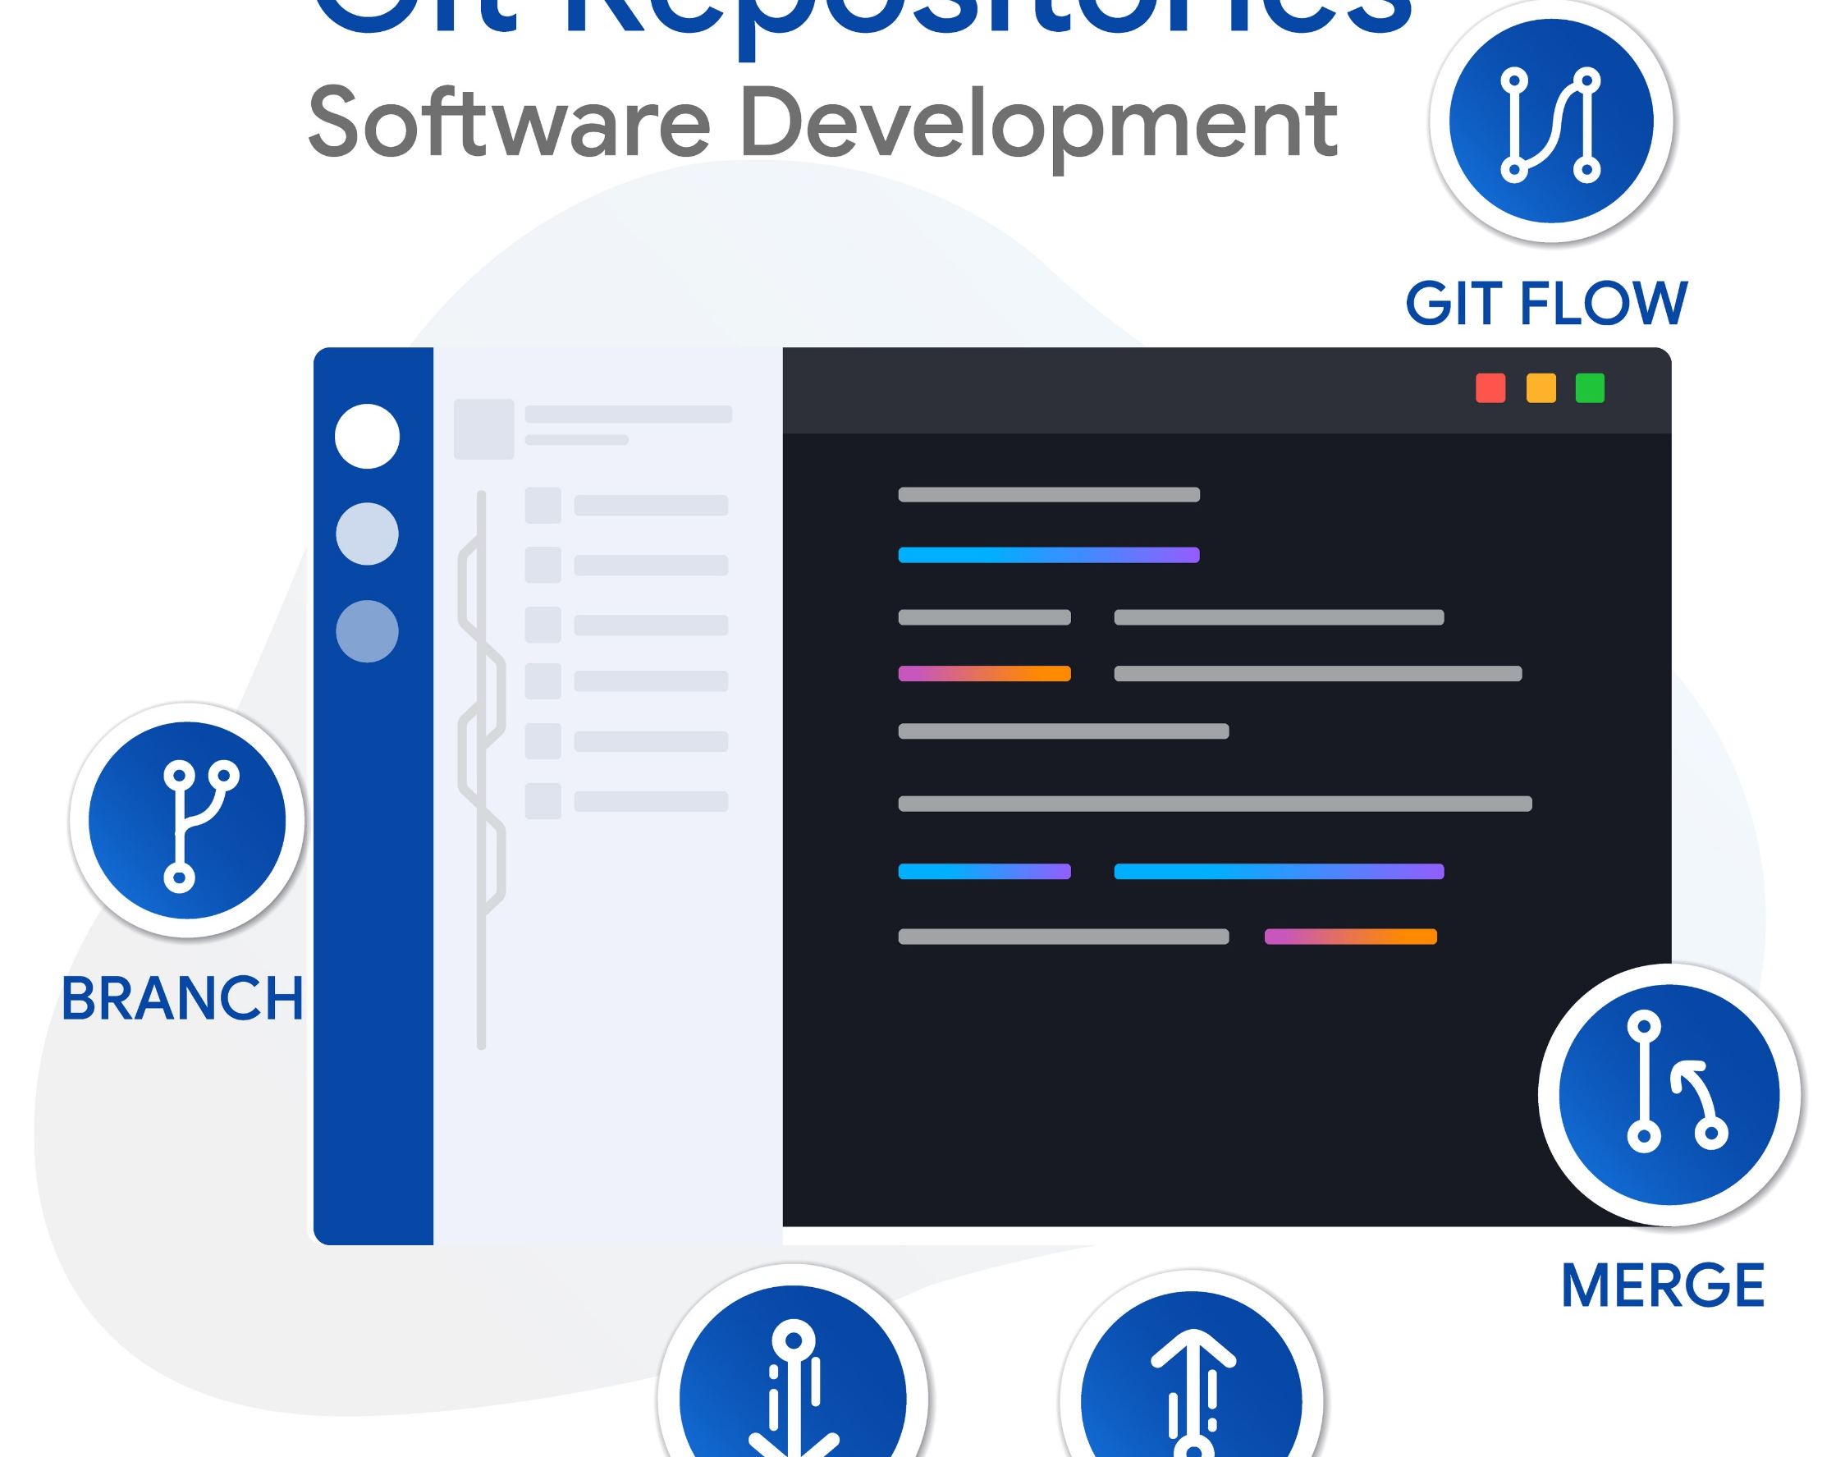
Pull Requests
Opportunities to Identify Technical Debt

Slide 86

Sprint Review
Opportunities to Identify Technical Debt

Slide 87

Stand Up
Opportunities to Identify Technical Debt

Slide 88

Coding
Opportunities to Identify Technical Debt

Slide 89

Manifesto for Software Craftsmanship
Not only working software,
but also well-crafted software
Not only responding to change
but also steadily adding value
Not only individuals and interactions
but also a community of professionals
Not only customer collaboration
but also productive partnerships
Notes:
As aspiring Software Craftsmen we are raising the bar of professional software development by practicing it and helping others learn the craft. Through this work we have come to value:

Slide 90

Code Analysis Tools
Opportunities to Identify Technical Debt

Slide 91

Often hidden in plain sight
Opportunities to Identify Technical Debt

Slide 92
Recoding Technical Debt
Technical Debt is not Free

Slide 93

Recording Technical Debt
User Story
Product Backlog Item
Requirement
Issue
Notes:
Agile – User Story
Scrum – Product Backlog item
CMMI – Requirement
Basic - Issue

Slide 94

Recording Technical Debt
User Story
Product Backlog Item
Requirement
Issue
Bug

Slide 95
Key Information to Record
Problem Statement
We need to refactor our SSO.
Notes:
Add business context when communicating technical debt.
Communicating the need for technical debt projects to business leaders is crucial, but often a challenge for technical leaders.

Slide 96
Key Information to Record
Problem Statement
In 22Q1, 20% of system outages were due to the SSO service straining under scale constraints. Given our focus on the enterprise segment, we are taking some time this quarter to ensure that part of the system is ready for us to continue to scale up this segment.
Notes:
By linking technical debt projects to measurable business outcomes, you make it easier to boost their priority, get approval for such projects, and make sure everyone understands the outcomes and why they are relevant to the entire company.

Slide 97
Key Information to Record
Problem Statement
Story Points
Criticality
Complexity
Reward
Remediation Cost
Notes:
Criticality – 1 to 5
Complexity – 1 to 5; how hard is it to solve the problem
Reward – 1 to 5 where 1 is a nice to have and 5 is a significantly measurable improvement both from a performance, security, complexity, etc. point of view

Slide 98
Tracking Technical Debt
Technical Debt is not Free

Slide 99

Tracking Technical Debt

Slide 100

Tracking Technical Debt

Slide 101

Technical Debt Register
Product
User Story #
Title
Criticality
Complexity
Reward
Remediation Cost
Technical Debt Score

Slide 102
Technical Debt Score
R : Reward
Cr : Criticality
Co: Complexity
(R x .2) + (CR x .15) - (CO x .15)

Slide 103
Technical Debt Score
R : Reward
Cr : Criticality
Co: Complexity
(R x .2) + (CR x .15) - (CO x .15)

Slide 104
Technical Debt Score
(R x .2) + (CR x .15) - (CO x .15)
Criticality (CR) | Complexity (CO) | Reward (R) | Score
5 | 1 | 5 | 1.6

Slide 105
Technical Debt Score
(R x .2) + (CR x .15) - (CO x .15)
Criticality (CR) | Complexity (CO) | Reward (R) | Score
5 | 1 | 5 | 1.6
1 | 5 | 1 | -0.4

Slide 106
Technical Debt Score
(R x .2) + (CR x .15) - (CO x .15)
Criticality (CR) | Complexity (CO) | Reward (R) | Score
5 | 1 | 5 | 1.6
1 | 5 | 1 | -0.4
3 | 2 | 3 | 0.75

Slide 107
Technical Debt Score
(R x .2) + (CR x .15) - (CO x .15)
Criticality (CR) | Complexity (CO) | Reward (R) | Score | Rank
5 | 1 | 5 | 1.6 | 1
1 | 5 | 1 | -0.4 | 3
3 | 2 | 3 | 0.75 | 2

Slide 108
Technical Debt Ratio
Technical Debt is not Free
Notes:
A simple ratio can show the technical debt as a relationship between the cost to fix the software system and the cost of developing it.

Slide 109
Technical Debt Ratio
(Remediation Cost / Development Cost) x 100%
Project | Remediation Cost | Development Cost | Technical Debt Ratio
Project 1 | 12.1 | 3633.12 | 0.33%

Slide 110
Technical Debt Ratio
(Remediation Cost / Development Cost) x 100%
Project | Remediation Cost | Development Cost | Technical Debt Ratio
Project 1 | 12.1 | 3633.12 | 0.33%
Project 2 | 702 | 18,728.55 | 3.75%

Slide 111
Technical Debt Ratio
(Remediation Cost / Development Cost) x 100%
Project | Remediation Cost | Development Cost | Technical Debt Ratio
Project 1 | 12.1 | 3633.12 | 0.33%
Project 2 | 702 | 18,728.55 | 3.75%
Project 3 | 1,058.25 | 9,593.37 | 11.03%

Slide 112
Summary
Technical Debt is not Free

Slide 113
Technical Debt is not Free
What is technical debt?
Notes:
What is technical debt?
A state of unnecessary complexity, duplication, subpar code, or otherwise deficient code that introduces risks in the form of time, quality, security, team morale, or other forms. Typically the results of past action or inaction.
Technical debt can be bad, it can be devastating; but it could also be useful and beneficial

Slide 114
Technical Debt is not Free
What is technical debt?
Pros and cons of technical debt
Notes:
Pros
Faster time to market
Short term competitive advantage
Short term capital preservation
Cons
Degradation of quality
Limits innovation
Longer development cycles
Reduces responsiveness to market changes
Higher upgrade costs
System compatibility issues
Poor end user experience
Develop

Slide 115
Technical Debt is not Free
What is technical debt?
Pros and cons of technical debt
Causes of technical debt
Notes:
Insufficient up-front definition
Business pressures
Tightly-coupled components
Parallel development
Lack of alignment to standards
Lack of knowledge
Poor technical leadership
Last minute specification changes

Slide 116
Technical Debt is not Free
What is technical debt?
Pros and cons of technical debt
Causes of technical debt
Types of technical debt
Notes:
Architecture
Build
Code
Defect
Design
Documentation
Infrastructure
People
Process
Requirement
Service
Test Automation
Test

Slide 117
Technical Debt is not Free
What is technical debt?
Pros and cons of technical debt
Causes of technical debt
Types of technical debt
Identifying technical debt
Notes:
Code Quality
Technical Deficiencies
Business Misalignment
Code Reviews
Pull Requests
Sprint Reviews
Stand Up
Coding
Code Analysis Tools

Slide 118
Technical Debt is not Free
What is technical debt?
Pros and cons of technical debt
Causes of technical debt
Types of technical debt
Identifying technical debt
Recoding technical debt
Notes:
Record in backlog
Probably not bugs
Add business context when communicating technical debt
Key Information to Record
Problem Statement
Story Points
Criticality
Complexity
Reward
Remediation Cost

Slide 119
Technical Debt is not Free
What is technical debt?
Pros and cons of technical debt
Causes of technical debt
Types of technical debt
Identifying technical debt
Recoding technical debt
Technical Debt Score
(R x .2) + (CR x .15) - (CO x .15)

Slide 120
Technical Debt is not Free
What is technical debt?
Pros and cons of technical debt
Causes of technical debt
Types of technical debt
Identifying technical debt
Recoding technical debt
Technical Debt Score
Technical Debt Ratio
(Remediation Cost / Development Cost)
x 100%

Slide 121
Thank You!
chadgreen@chadgreen.com
TaleLearnCode
ChadGreen.com
ChadGreen & TaleLearnCode
ChadwickEGreen
github.com/TaleLearnCode/TechnicalDebtIsNotFree

